Slide 1


Department of ECE
LEARNATHON
PROJECT TITLE: Smart Vision-Based Attendance System
Presented by:
V. Niteesh Kumar Joshi - 2300049053
S. Venkata Swaroop - 2300049055
O. Vinay - 2300049056
K. Venkata Hemanth - 2300049067
Guided by:
DR.A.V.PRABHU

Slide 2



AIM OF THE PROJECT
The Aim of this project is to develop a smart vision-based classroom attendance system that utilizes facial recognition technology with blink-based liveness detection to ensure secure and accurate attendance marking.
The system is designed to prevent proxy attendance and spoofing attempts, automate attendance logging in digital formats such as Excel or cloud-based sheets, and provide real-time notifications while supporting multi-class scheduling for efficient academic management.
PROBLEM STATEMENT:-
Traditional attendance systems used in classrooms are often time-consuming, inefficient, and prone to errors.
Manual roll-calling consumes valuable lecture time, while RFID or ID-card-based systems are vulnerable to proxy attendance.
Additionally, students may mark attendance and leave the classroom without actually attending the session.
Existing systems also lack proper verification mechanisms to prevent photo or video spoofing and do not provide automated real-time reporting or multi-class schedule management.

Slide 3
LIST OF THE COMPONENTS
HARDWARE COMPONENTS REQUIRED:
ESP32 Development Board
External USB Webcam
Laptop / PC
USB Cable
Power Adapter / Power Supply
Wi-Fi Router / Internet Connection

Slide 4
LIST OF THE COMPONENTS
SOFTWARE COMPONENTS REQUIRED:
Python Environment
OpenCV
dlib
Face Recognition Library
Pandas & OpenPyXL
Google Sheets API
Telegram Bot API

Slide 5

ABSTRACT
This project proposes a smart vision-based attendance system using facial recognition technology.
It captures live images through a webcam and verifies student identity in real time.
Blink-based liveness detection is implemented to prevent photo and video spoofing.
The system eliminates proxy attendance and reduces manual errors.
Attendance records are automatically stored in Excel or cloud-based sheets.
Multi-class scheduling support allows seamless handling of different subjects and sessions.
Real-time Telegram notifications are sent to students after successful verification.
The system improves efficiency, security, and transparency in classroom attendance management.

Slide 6
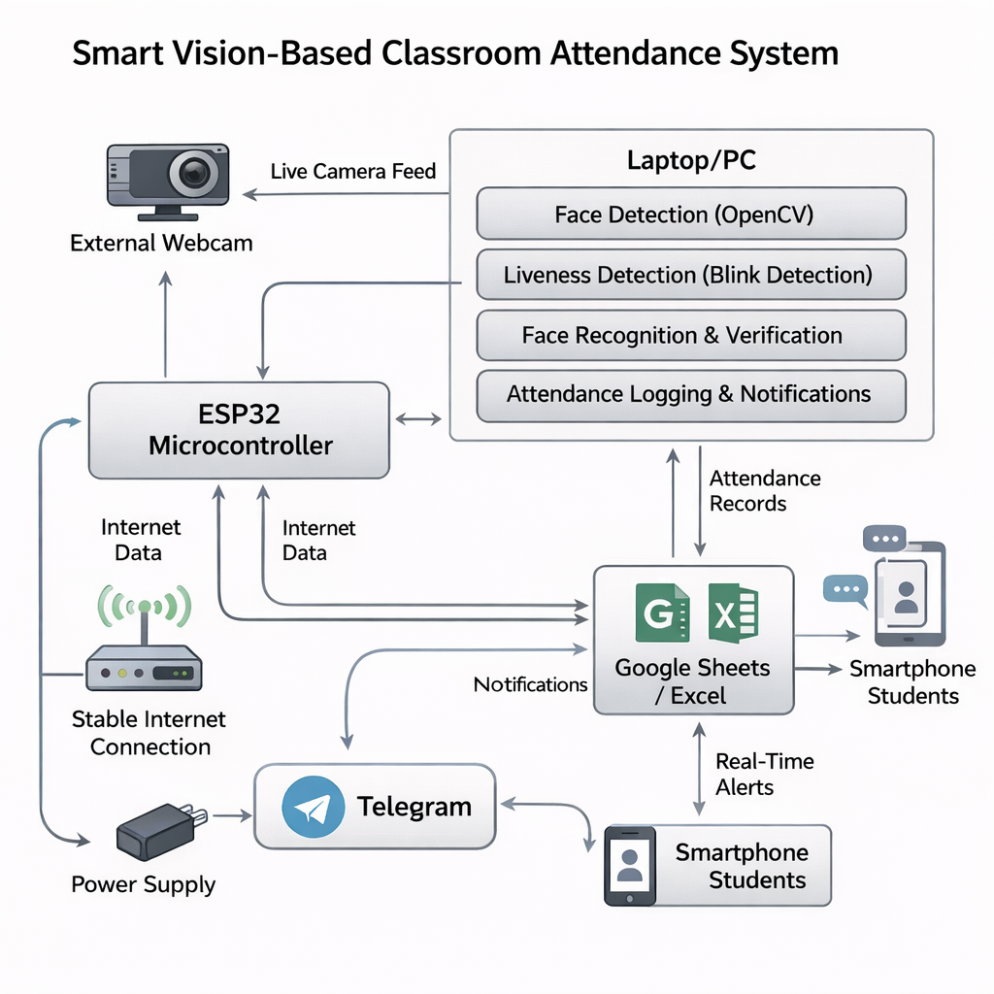
BLOCK DIAGRAM

Slide 7
WORKING
The system prevents duplicate entries within the same session.
The student scans their RFID card at the classroom entry point.
The ESP32 reads the RFID UID and sends the student ID to the laptop via serial/Wi-Fi communication.
The system checks whether the RFID ID is registered in the student database. Upon validation, the external webcam captures the student’s live image.
The captured face is detected using OpenCV and compared with the stored facial data of that specific RFID ID.
If a facial match is found, blink-based liveness detection is performed to ensure the person is physically present.
If no blink is detected or the face does not match, attendance is rejected.
If both identity and liveness are verified, the system marks the student as present.
The system records attendance details including Name, Date, Time, and Subject based on the scheduled class.
The attendance data is automatically stored in Excel or Google Sheets.
A Telegram notification is sent to the student confirming successful attendance marking.

Slide 8
FUTURE SCOPE
Integration with full campus ERP systems for centralized academic management.
Deployment using edge AI devices for faster real-time processing without a laptop.
Mobile application integration for live attendance tracking and analytics.
Advanced anti-spoofing techniques such as 3D face depth detection and gesture verification.
Cloud-based dashboard with attendance analytics and performance insights.
Automatic report generation for faculty and administration.
Multi-camera support for large classrooms and seminar halls.
Integration with access control systems for smart classroom entry.

Slide 9
CONCLUSION
The proposed system provides a secure and automated solution for classroom attendance management.
By combining RFID verification, facial recognition, and blink-based liveness detection, the system effectively prevents proxy attendance and spoofing.
Automated logging and real-time notifications improve efficiency, accuracy, and transparency.
The system reduces manual effort while ensuring reliable multi-class attendance tracking.
Overall, the project demonstrates a practical and scalable approach to modern smart classroom management.

Slide 10
TEAM MEMBERS DETAILS
Presented by:
V. Niteesh Kumar Joshi - 2300049053
S. Venkata Swaroop - 2300049055
O. Vinay - 2300049056
K. Venkata Hemanth - 2300049067

Slide 11
THANK YOU
23SDEC06A– EMBEDDED DESIGN

